Slide 1
Accurate Spatial Calibration of RFID Antennas via Spinning Tags
Presenter: Chunhui Duan
Author: Chunhui Duan, Lei Yang and Yunhao Liu
Jun.30, 2016
Notes:
Good morning everyone. I’m Chunhui Duan from Tsinghua University, China. I’ll present our work named “Accurate Spatial Calibration of RFID Antennas via Spinning Tags”.

Slide 2
Outline
01.
Motivation
02.
Contribution
03.
Overview
04.
Technical Details
05.
Implementation & Evaluation
06.
Conclusion
Notes:
My talk has six components.

Slide 3
1
Motivation

Slide 4
Benefits of Tag Localization
Human-computer interface
Notes:
As we know, most of the work in RFID localization domain paid attention on how to accurately locate the RFID tags instead of readers.
Many applications would benefit from accurate tag localization or tracking.
For example, we can enable human-machine interaction with the tag attached on the finger.

Slide 5
Benefits of Tag Localization
Baggage sortation in airport
Notes:
Besides, by tagging each object, it can also aid in baggage sortation in the airport and so on.

Slide 6
Our Focus
RFID Reader (Antenna) Calibration
Manual Calibration
Time-consuming, laborious and sometimes inaccurate.
Notes:
But, our focus in this paper is the problem of reader calibration. Considering previous work locating tags, all of them have a mandatory precondition that the reader’s location is known or calibrated in advance. And this calibration procedure is often conducted manually, which can be time-consuming, laborious and inaccurate, especially when many antennas are required.

Slide 7
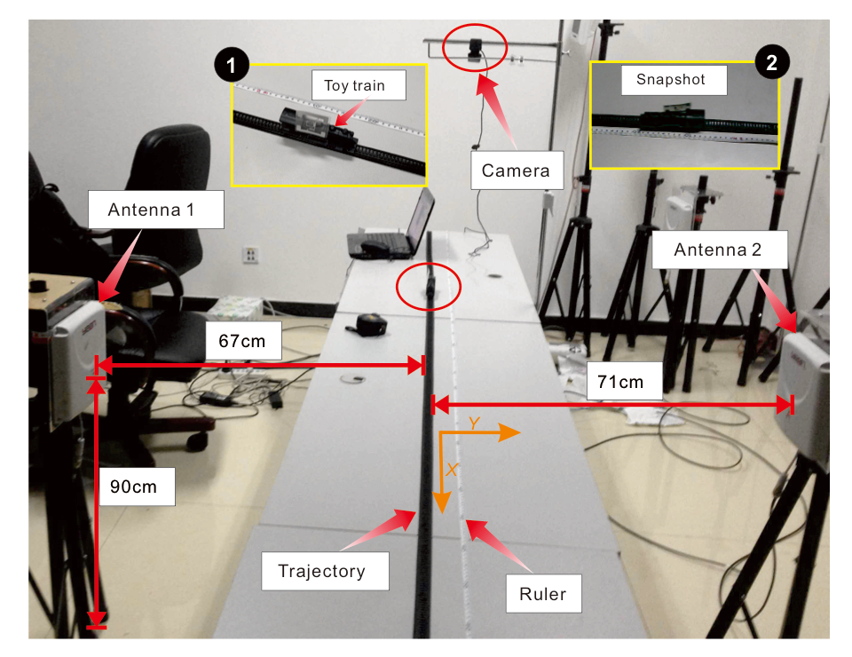
Our Focus
Total 4 antennas deployed
Time cost: 20~30 mins
Energy cost: exhausting and boring
Tagoram (Mobicom’14)
A simple, convenient and accurate way of calibration is needed.
Notes:
Here we take the work in Mobicom’14 as an example. It takes us over 20 minutes to calibrate all four antennas deployed. And the manual calibration itself is exhausting and boring.
So a simple, convenient and accurate way of calibration is needed.

Slide 8
2
Contribution
Notes:
Based on this,

Slide 9
Tagspin
Gives an innovative improvement to the previous AoA-based localization
First proposes that there exists a regular pattern between tag’s phase measurements and its orientations
We implement the system with COTS RFID products and evaluate it comprehensively
Notes:
Based on this, we propose the Tagspin system and it makes the following contributions.
Firstly, we give an innovative improvement to the traditional AoA-based localization method.
Secondly, we are the first to propose the finding that there exists a regular pattern between tag’s phase measurements and its orientations.
Thirdly, we implement the system with COTS RFID products and evaluate it comprehensively.

Slide 10
3
How Tagspin works?
Overview the basic idea
Notes:
So how does our system work?

Slide 11
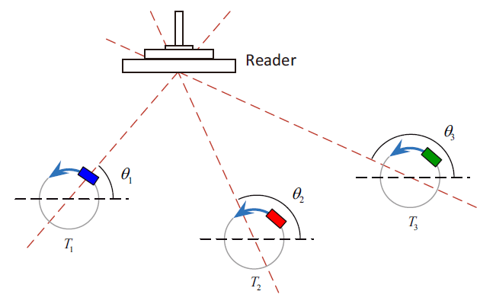
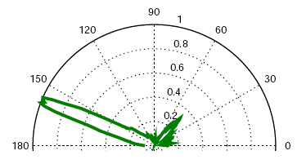
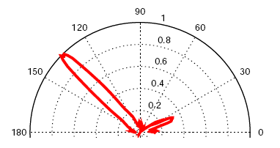
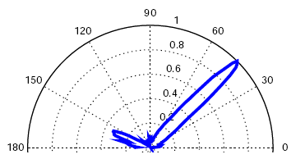
Basic Idea
Notes:
The basic idea is very simple. We adopt the Angle-of-Arrival method. Each spinning tag mimics a circular antenna array. Then an SAR-based method is designed to estimate the relative power profile over all spatial angles. The profile will have a sharp peak at the real direction from tag to reader. Finally, we can pinpoint the target from the intersection of these lines.

Slide 12
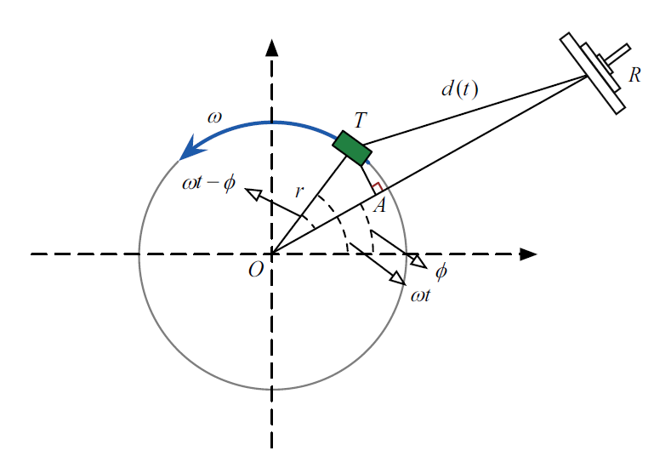
Acquiring Phase Shifts
Diversity term
Collected phase
Notes:
We now go deep into the details. As the tag spins around, the collected phase value is a periodic function which will repeat every time it completes a rotation. The collected phase here also has a diversity term. This is caused by the device hardware characteristics.

Slide 13
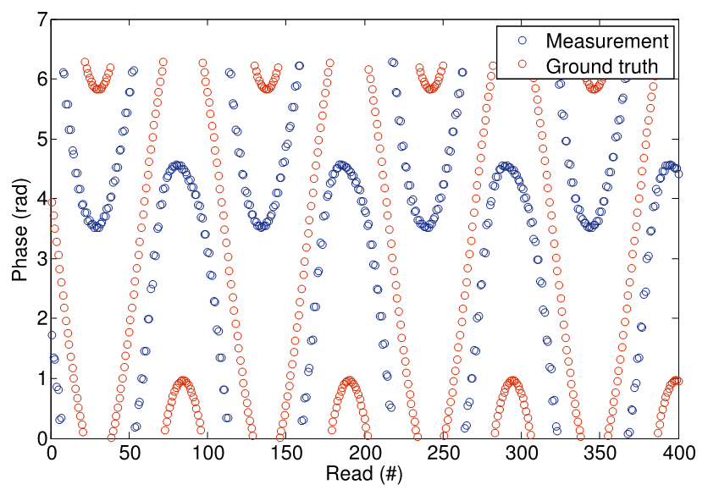
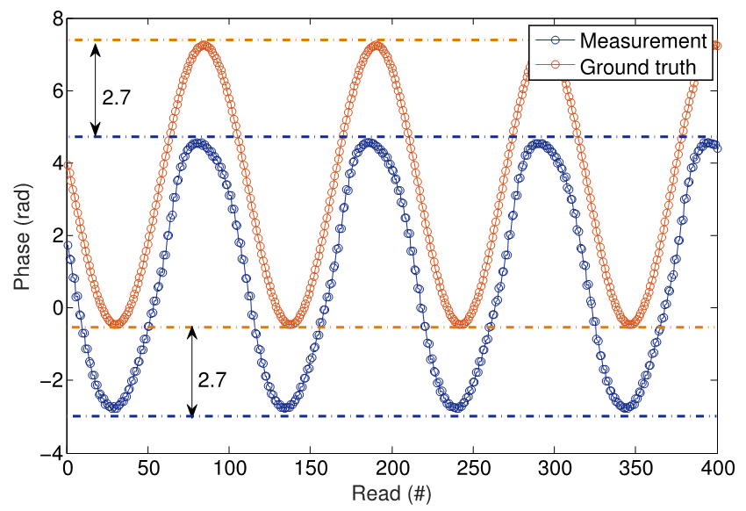
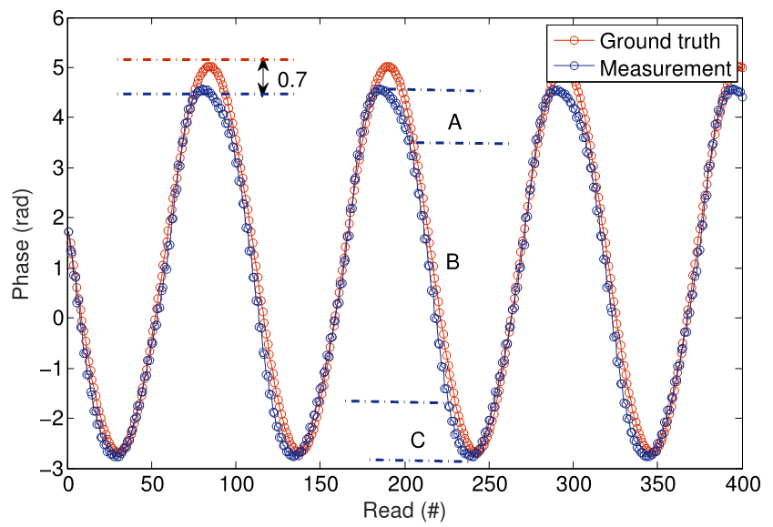
Calibrating Phase Shifts
Misalignment
Original phase shifts
Smoothed phase shifts
Calibrating the diversity
Calibrating the orientation
Gap
Notes:
1. To further study the phase pattern of the spinning tag, we conduct the following experiments. We collect the original phase shifts by attaching the tag onto the edge of a rotating disk. As expected, the original phase shifts show regular pattern. But the curve is not continuous because of the mod operation. 2. So we smooth the curve and find that there are about 2.7 radians misalignment between the measurement and ground truth. As we mention before, the misalignment results from the diversity factor and relatively remains unchanged under the same macro environment. So we can subtract it by using the first value as a reference. More details will be given later.
3. Here is the result after eliminating the diversity factor. As we can see, there are still about 0.7 radians gap between the measurement and ground truth especially around the peaks.

Slide 14
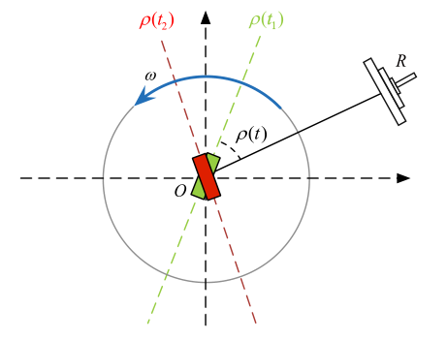
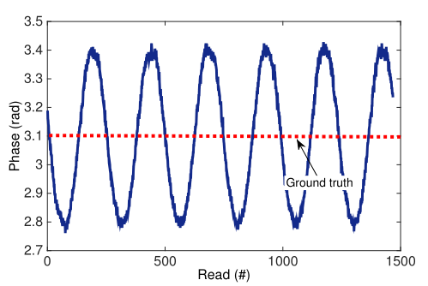
Orientation’s Impact
Regular fluctuation
Experiment
Observation
Notes:
To explore the reason, we conduct another experiment by attaching the tag at the center of the rotating disk. We have the observation that even location remains the same, with the orientation of the tag changing, the measured phase also exhibits small but regular fluctuation.
We further test more tags of different models and come to this key observation.

Slide 15
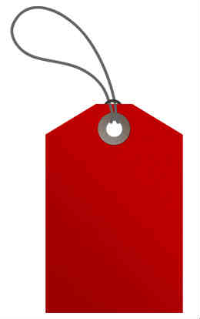
Orientation’s Impact
$$Key observation$$
Tag’s phase value has an inherent correlation with its orientation relative to the reader antenna.
This specific correlation can be quantified as a function through data fitting using Fourier series.
Notes:
Tag’s phase value has an inherent correlation with its orientation, namely the angle between the tag plane and the line from tag to reader.
And this specific correlation can be quantified as a function through data fitting using Fourier series.

Slide 16
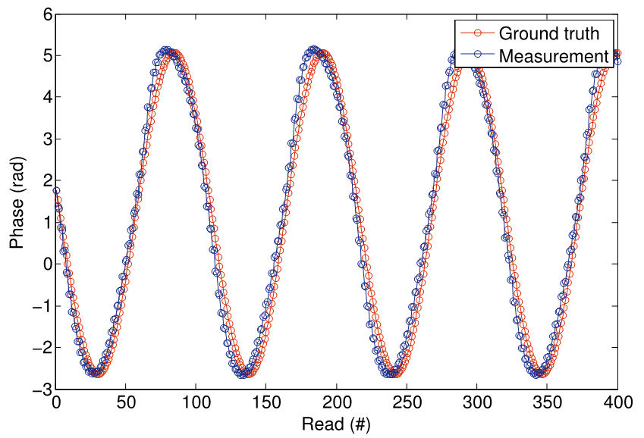
Calibrating Phase Shifts
Misalignment
Original phase shifts
Smoothed phase shifts
Calibrating the diversity
Calibrating the orientation
Gap
Notes:
4. Then after we mathematically account for the tag orientation’s influence, we can clearly see from the last figure that the phase measurements become more consistent with the ground truth. This will be very useful for improving the final accuracy.

Slide 17
4
Technical Details
Notes:
After acquiring the phase shifts, we now look at our system’s technical details.

Slide 18
Traditional AoA Approach
Measured phase
Wireless channel parameter
Theoretical phase
Power profile
Notes:
(Our theoretical basis is that the tag’s phase rotation will exhibit different value patterns if the reader signal’s angle of arrival changes. )
To understand the basic principle behind our method, let’s first introduce how the traditional AoA approach works under our scenario.
From basic channel models, the wireless channel parameter hi measured at the i th snapshot can be expressed as the complex number. And θi denotes the measured phase, which should equal the theoretical value in the ideal situation.
Then the power profile along each direction φ is generated. When we traverse through all the possible angles, theoretically the function P will get maximum if and only if φ equals the reader’s real direction.

Slide 19
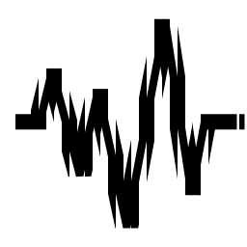
Challenges
Device diversity
Thermal noise
Notes:
But unfortunately, in real environment, we are facing the challenges of device diversity and thermal noise.

Slide 20
Eliminating the Diversity
Use the first value as reference
Measured phase
Theoretical phase
$θ$div (diversity term) is eliminated
$D$ (distance variable) is removed
Notes:
As we mention before, the hardware diversity will cause misalignment between the measured and theoretical phase. If we use the first value as a reference, as we can see from this formula, both the diversity term and distance variable can be removed.

Slide 21
Eliminating the Diversity
New form of power profile
Need to deal with thermal noise
Notes:
So we get a new form of power profile Q by dividing P with the square of h1. Although the misalignment problem is solved by doing this, we still need to deal with thermal noise.

Slide 22
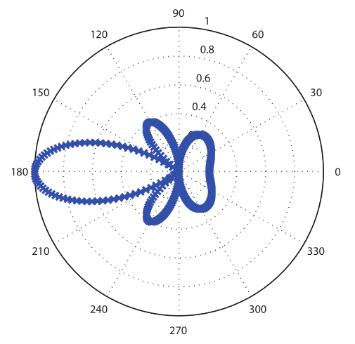
Proposed Method
Ground truth
$$θ∼𝒩(μ,σ)$$
Varying with $d$
$$σ=0.1$$
Original power profile
Modeling
Observation
PDF
Large continuous region
Susceptible to noise
$$f(θ;μ,σ)$$
Notes:
We now introduce how our proposed method works. Let’s first look at the simulation result of the original power profile. We observe that, it has a peak at the reader’s real direction, which is consistent with the ground truth. But there also exists a large continuous region around the ground truth with relatively high power values. This may decrease the accuracy and make the result easily affected by noise.
Inspired from previous work, we know that tag’s phase measurements contain random errors, following a typical Gaussian distribution with a standard deviation of 0.1 radians. So we should regard the phase as a random variable instead of a constant.

Slide 23
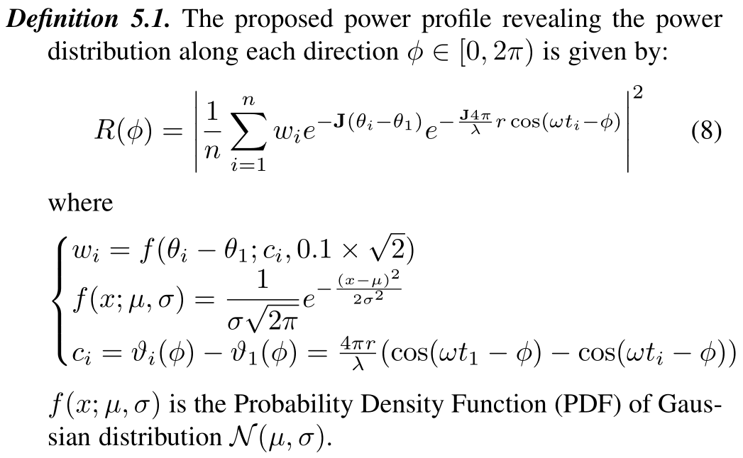
Proposed Method
Proposed power profile
$$θ_{i}−θ_{1}∼𝓝(c_{i}, 0.1\sqrt{2})$$
Probability of $φ→φ_{R}$
Notes:
To eliminate the impacts from the thermal noise, we propose a new power profile which is given by R.
Here we add a probabilistic weight wi to each virtual signal. And $θ_{i}−θ_{1}$ is a random variable, which should follow this Gaussian distribution.
(wi indicates the possibility the angle $φ$ being the ground truth. )Then the power profile is enhanced for angles with higher probability to be the ground truth and weakened for others.

Slide 24
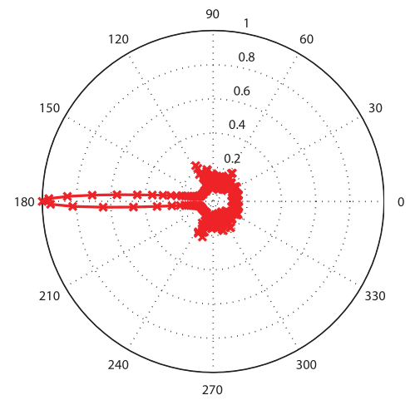
Simulation in 2D
Ground truth
Ground truth
Original power profile
Proposed power profile
Observation
Observation
Large continuous region
Susceptible to noise
Ground truth is highlighted
Robust to noise
Notes:
As we can see from the simulation results at the right figure, the real angle of arrival is highlighted.
Compared to the original power profile, our proposed method is more accurate and robust, especially under strong noise environment.
This can be very meaningful because the precision of AoA has a direct impact on the final positioning accuracy.

Slide 25
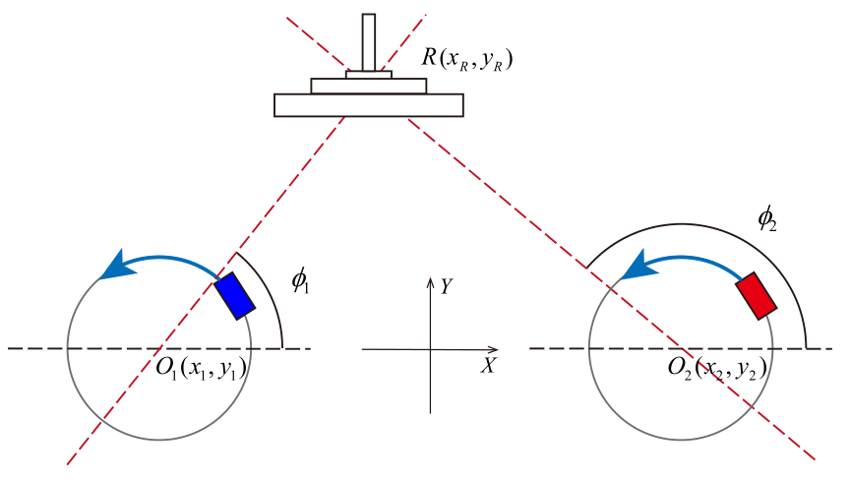
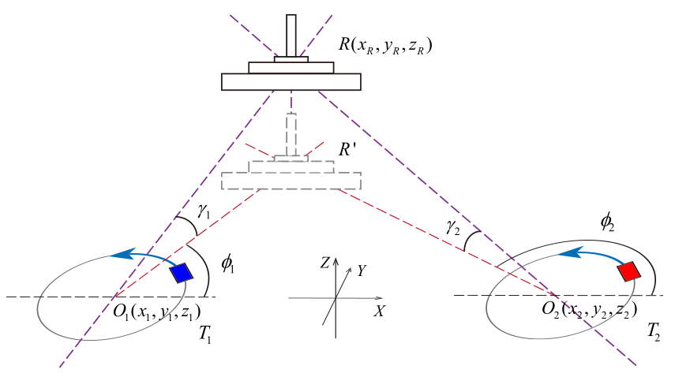
Locating the Target
3D
Polar angle
Azimuthal angle
Notes:
To locate the target reader, we only need to intersect the angle spectrums of two spinning tags.
Our method can still work when applying to three dimensional scenario. To fully describe a spatial direction, in addition to the azimuthal angle φ along the horizontal plane, we also need another parameter γ to indicate the polar angle along the vertical direction. The target’s location can still be well determined with only two spinning tags. You can refer to our paper for more details.

Slide 26
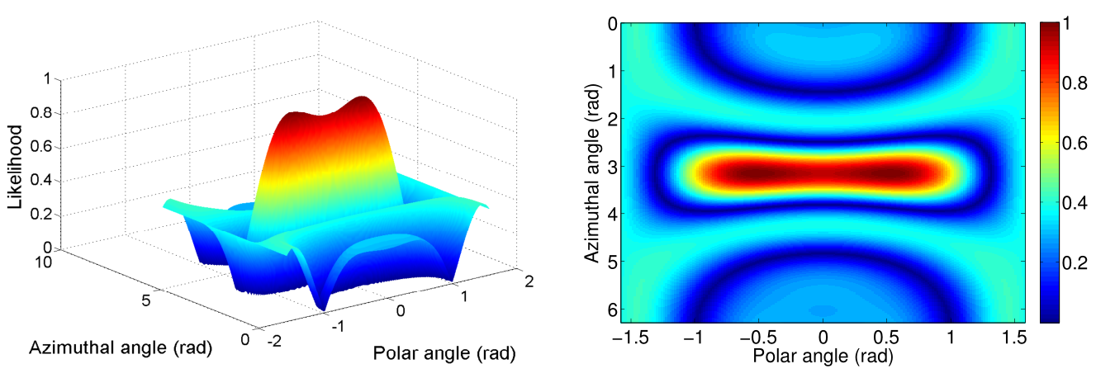
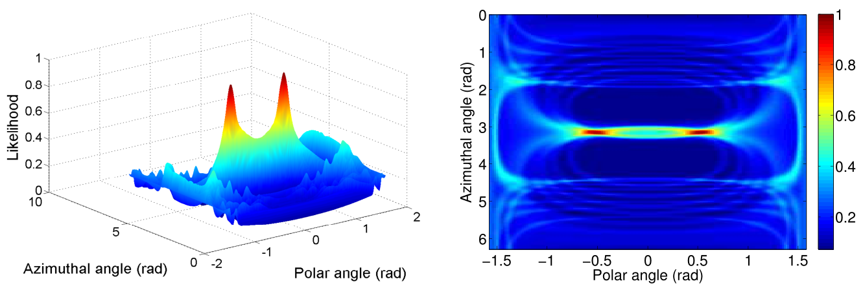
Simulation in 3D
Original power profile
Proposed power profile
Notes:
Simulation results also show that even in three dimensional space, our proposed power profile still performs much better than the original one.

Slide 27
5
Implementation & Evaluation
Notes:
We implement our system and evaluate its performance.

Slide 28
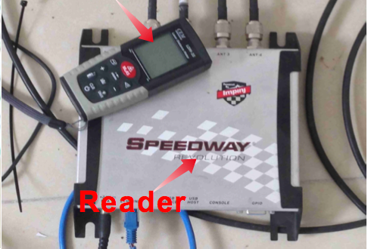
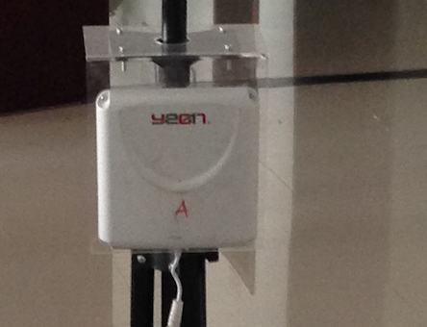
Hardware & Software
Reader
Tag
Software
ImpinJ R420 reader.
Alien 2 × 2 Inlay
EPCglobal LLRP
Java
Directional antenna
Alien Squiggle Inlay
Notes:
Here are the specifications of reader, tag and software.
We adopt an ImpinJ Speedway modeled R420 reader without any hardware or firmware modification. The reader supports
four directional antennas at most.
Totally five types of tags are employed. We only list two of them here.
Software:
We adopt LLRP protocol to communicate with the reader and implement our software using Java language.

Slide 29
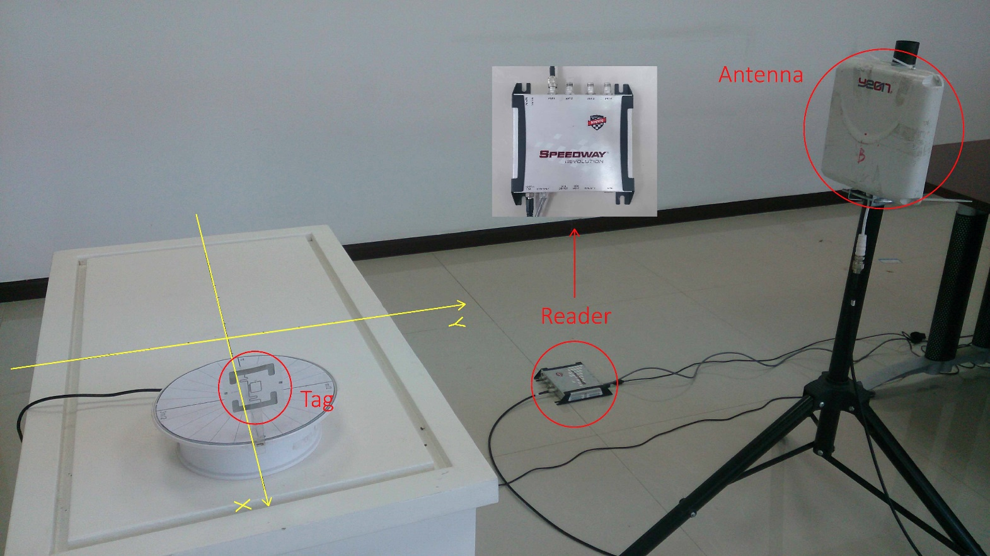
Experimental Setup
The tag is spinning around by attaching onto the edge of a rotating disk.
Four antennas can be calibrated at the same time.
Notes:
This figure shows the experimental setup.
We make the tag spinning by attaching it onto the edge of a rotating disk.
Since the Impinj reader we adopt supports four antennas at most, our system can calibrate four antennas at the same time, which saves the time cost efficiently.

Slide 30
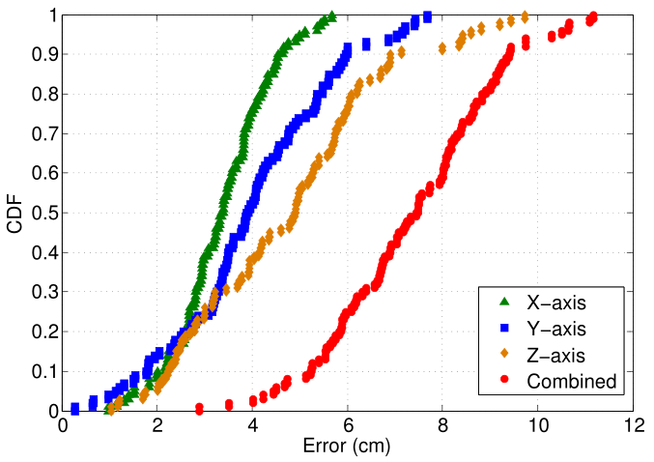
Localization Accuracy
Tagspin achieves a mean accuracy of 7.3cm in 3D
Notes:
One of the most important metrics of our system is localization accuracy. Tagspin achieves a mean accuracy of 7.3cm in combined dimension with standard deviation of 1.8cm in 3D space. And the error in two dimensional case is 5.3cm.

Slide 31
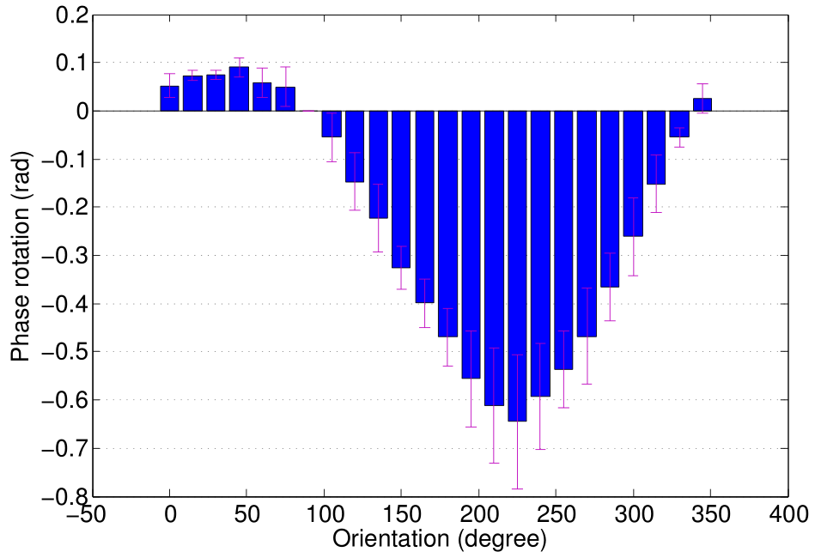
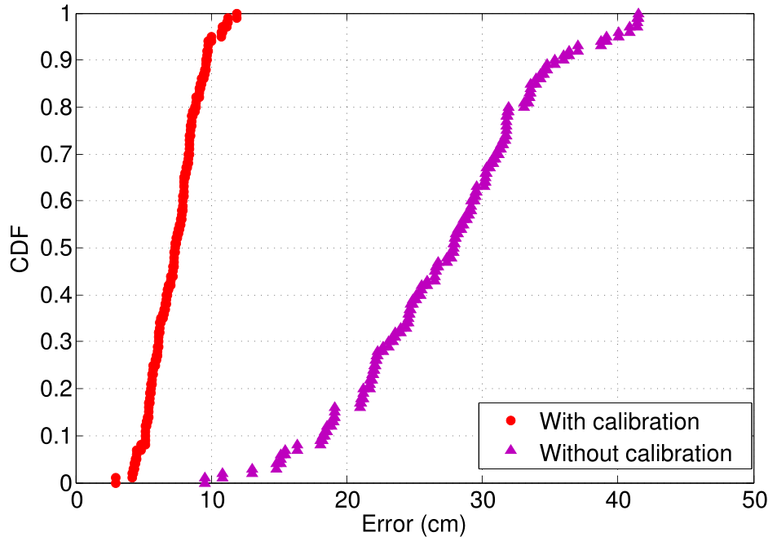
Impact of Orientation
Mean: 7.3cm
After calibration
Mean: 27cm
Notes:
As we mention before, the tag orientation’s impact is non-ignorable.
This figure shows that there exhibits stable regularity between orientation angle and corresponding phase value.
After we calibrate this impact, the positioning accuracy can be dramatically improved, as we can see in the figure below. If we don’t consider this, the mean error is increased to 27cm. So our idea can improve the accuracy by more than three times, which is substantial in indoor environment.

Slide 32
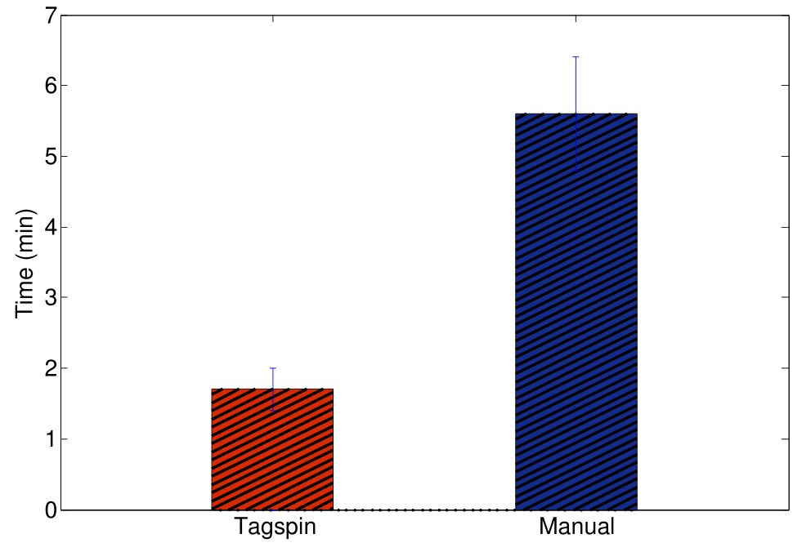
System Overhead
Tagspin’s time cost is 1.7min
on average
Notes:
When we consider Tagspin’s performance, especially compared to traditional manual calibration, the system overhead is also an important metric.
It only takes our system 1.7min on average to finish the whole localization procedure, which is much faster than manual method.

Slide 33
Conclusion
Propose a light-weighted, inexpensive yet precise reader calibration system with only a few spinning tags.
Tagspin fills in the gap of RFID reader localization domain.
It quantifies the correlation between tag orientation and phase measurement.
Notes:
In summary, we propose the Tagspin system which is light-weighted, inexpensive yet highly precise with only a few spinning tags.
Tagspin fills in the gap of RFID reader localization domain and it quantifies the tag orientation’s impact.

Slide 34
Questions?
T
hank you
Notes:
That’s all of my talk. Welcome for questions. Thank you!

