Slide 1
Fusing RFID and Computer Vision for Fine-Grained Object Tracking
Chunhui Duan, Xing Rao, Lei Yang, Yunhao Liu
May 4, 2017
Notes:
Good morning everyone. I’m Chunhui Duan from Tsinghua University, China. I’ll present our work named “Fusing RFID and Computer Vision for Fine-Grained Object Tracking”.

Slide 2
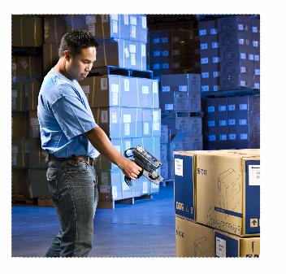
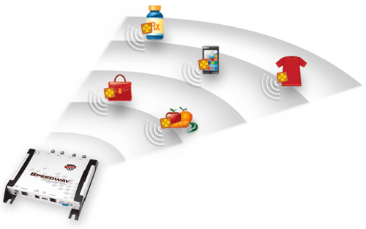
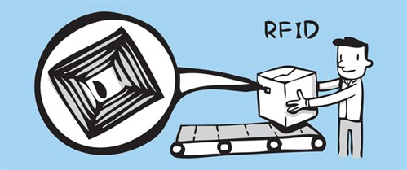
RFID-based Applications
Notes:
As we know, RFID technology has got broad applications in every day scenario, such as warehouse inventorying, baggage sortation in the airport and so on. And many applications would benefit from knowing the accurate location of RFID tag.

Slide 3
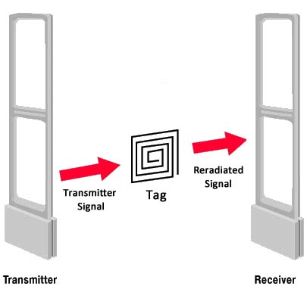
Drawback of RFID-based EAS
Electronic Article Surveillance System
False alarm
Deficient localization capability
Notes:
A recent usage of RFID is in the Electronic Article Surveillance (EAS) system, which aims at preventing goods from being stolen. But existing RFID-based EAS systems are suffering from the drawback of false alarm, which degrades the performance dramatically. If we can acquire the tag’s accurate trajectory, this problem can be better solved. However, tag localization itself is a challenging task especially in passive backscatter systems.

Slide 4
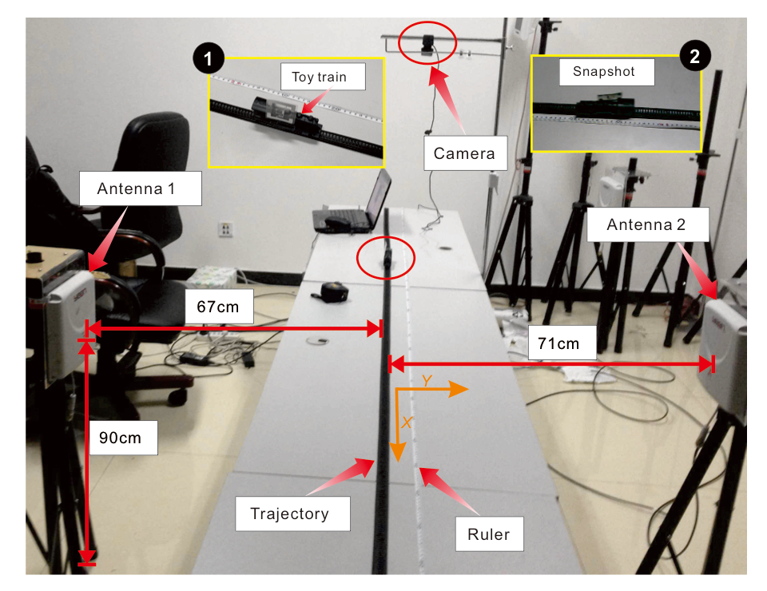
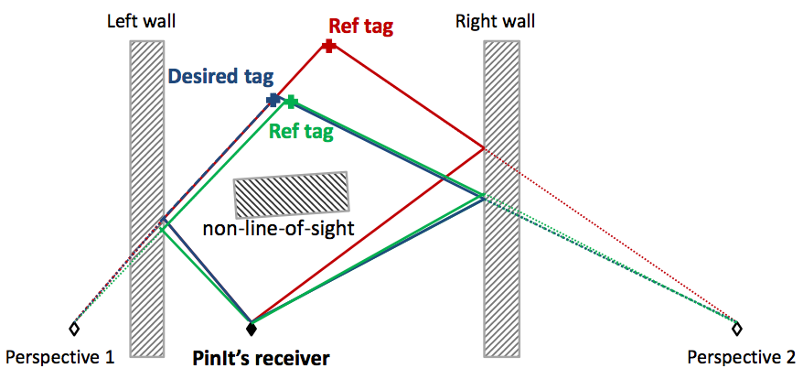
Drawback of Prior Localization Work
Tagoram [MobiCom’14]
Multiple antennas are
required
PinIt [SIGCOMM’13]
Pre-deploy a large number of reference tags
Notes:
Traditional approaches either require multiple antennas or need to pre-deploy a large number of reference tags.

Slide 5
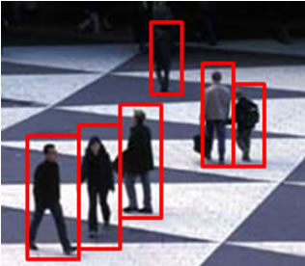
Drawback of CV
Computer Vision
Who is who?
Object identification
Notes:
On the other hand, recent years have seen the Computer Vision (CV) technology progress to a remarkable state and we can achieve reliable tracking of individual objects or people from video segments at low cost.
But, CV systems are not able to distinguish specific object from each other , e.g., an item is found stolen in the site but there may be multiple people captured by the monitoring camera, making it difficult to identify the thief.

Slide 6
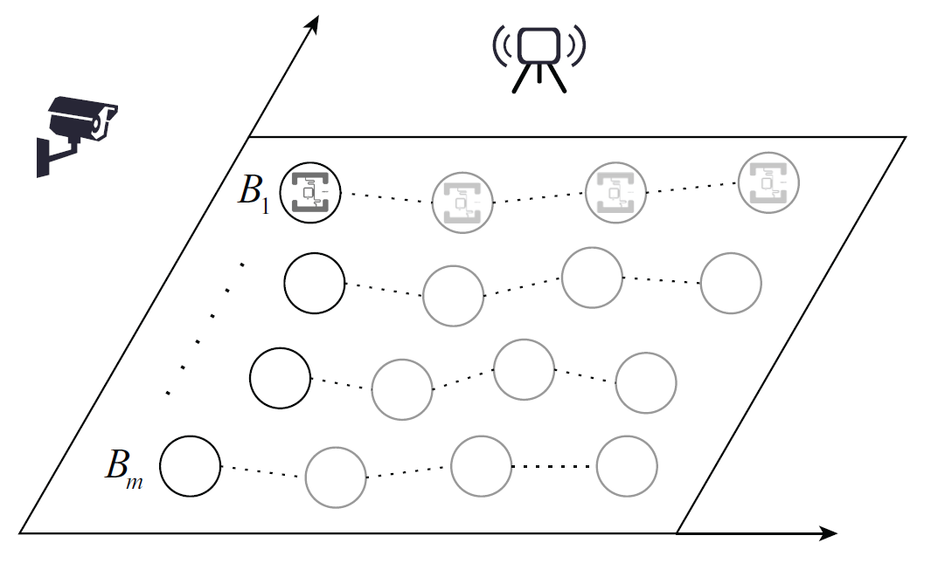
TagVision
A hybrid RFID and CV system for fine-grained tracking of tagged object
Notes:
Based on this, we propose TagVision, a hybrid RFID and CV system for fine-grained tracking of tagged object, utilizing only one RFID antenna and common camera.
Here illustrates a toy example of the scene. There exist multiple moving objects, also referred as motion blobs and one of them has the RFID tag attached. Our goal is to track the tagged object with high accuracy, using one antenna and camera.

Slide 7
Our Contributions
Our Contributions
TagVision makes an innovative combination of the computer vision and RFID technologies, utilizing the advantages of both.
1
A fusion algorithm is designed to seamlessly link the location information output by the CV subsystem to the phase data collected by the RFID subsystem.
2
3
We implement the system purely with COTS camera and RFID products.
Notes:
To summarize, our contributions are mainly three folds, first, makes an innovative combination of the computer vision and RFID technologies, utilizing the advantages of both. Secondly, a fusion algorithm is designed to seamlessly link the location information output by the CV subsystem to the phase data collected by the RFID subsystem.
Besides, we implement the system purely with COTS camera and RFID products.

Slide 8
Technical Details
Notes:
So how does our system work?

Slide 9
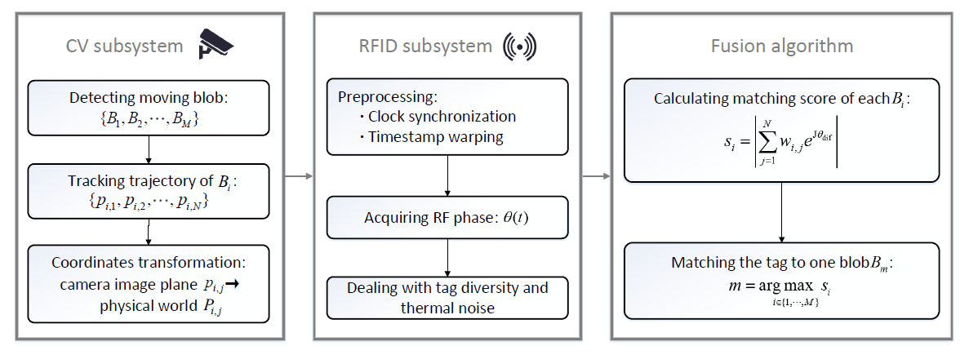
System Architecture
Tracking
Identifying
Matching
Notes:
Here is the system architecture. As we mention before, TagVision is composed of two subsystems, where CV subsystem focuses on detection and accurately tracking of motion blobs and RFID subsystem aims at identifying specific tag with the collected phase values. Then, a fusion algorithm is employed to combine the two subsystems’ information to get the trajectory of the target.

Slide 10
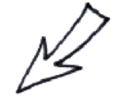
CV Subsystem
Motion blob detection and tracking
Lucas-Kanade
optical flow method
Notes:
Let’s go into the details.
In the CV subsystem, with the image frames acquired by the camera, we utilize the Lucas-Kanade optical flow method to detect motion blobs.
And in order to track the individual blob over consecutive video frames, a mean-shift tracking approach is applied.

Slide 11
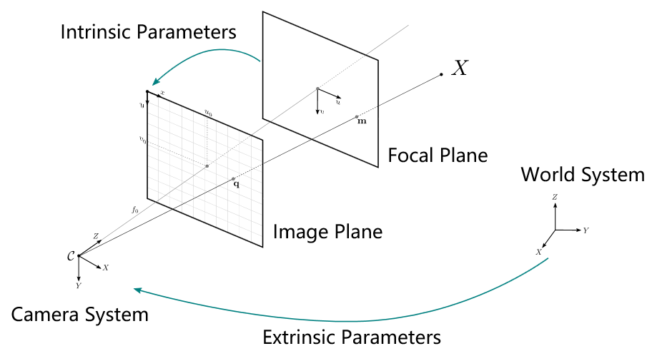
CV Subsystem
Coordinates transformation
Notes:
As our final goal is to get the trajectory in the real world, so we need to transform the pixel coordinates we get from the camera image plane to the physical world system.
This transformation can be represented by the camera’s intrinsic and extrinsic parameters.

Slide 12
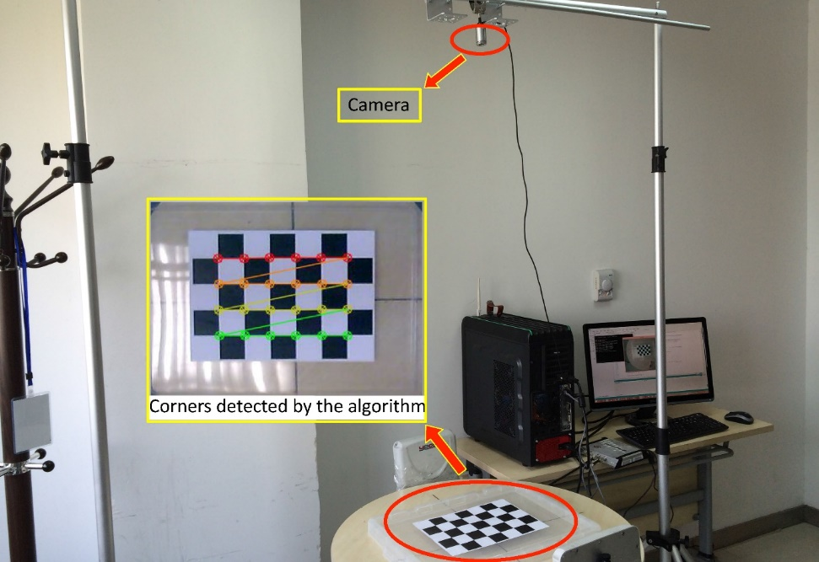
CV Subsystem
Coordinates transformation
Camera parameters:
Intrinsic matrix
Extrinsic matrix
Distortion coefficients
Camera calibration
Notes:
Then we calibrate the camera for all the above mentioned parameters, by letting the camera observe a planar pattern shown at a few different orientations.

Slide 13
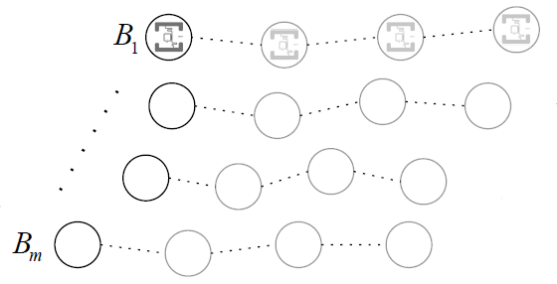
Trajectories:
Notes:
Finally, the CV subsystem outputs the real-world trajectories of all the moving objects.

Slide 14
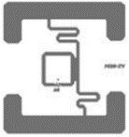
RFID Subsystem
Phase model
Output by the CV subsystem
$$d(t)$$
$A$
$$\left.P_{i}(t\right)$$
Collected phase
Device diversity
Notes:
We now look at the RFID subsystem.
The phase is a common parameter supported by commercial RFID readers. When the tag moves, the collected phase θ(t) changes regularly with the distance d(t) between the reader and tag. There is also a diversity term here, which is caused by device hardware characteristics. As the phase is directly related to the distance, which in turn can be inferred from the tracking results output by the CV subsystem, so what we need is a fusion approach to associate the location information generated by the CV subsystem to the phase data collected by the RFID subsystem.

Slide 15
Basic idea
Match the acquired phase
sequence to specific motion blob.
Matching mechanism (fusion algorithm)
Notes:
And our basic idea is very simple. As we already get all the moving objects’ trajectories, and one of them should be the tag’s. So we just need to match the acquired phase sequence to one of these motion blobs.

Slide 16
Fusion Algorithm
Blob matching
Assign a matching score $s_{i}$ to each motion blob $B_{i}$
$$s_{i}$$
How to define the matching score?
Notes:
This matching procedure is called as blob matching. Specifically, we assign a matching sore si to each motion blob Bi, which describes the possibility that the RFID tag is on the object.
Then the problem is, how to define the matching score?

Slide 17
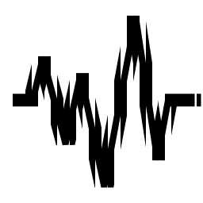
RFID Subsystem
Phase calibration
Device diversity
Environmental noise
Notes:
As we mention before, in real environment, the phase value is influenced by device diversity and thermal noise.

Slide 18
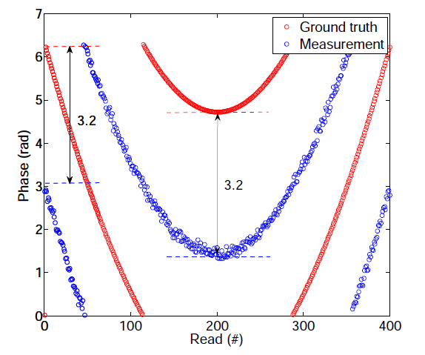
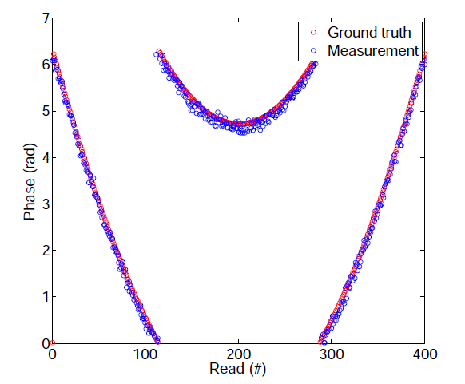
RFID Subsystem
Phase calibration
Theoretical phase
Measured phase
$θ$div is removed
Notes:
The hardware diversity will cause misalignment between the measured and theoretical phase, as the left figure show here, and the misalignment remains relatively unchanged under the same macro environment.
If we use the first value as a reference, as we can see from this formula, the diversity term can be removed by the subtraction.
After calibrating the phase, the measurement becomes consistent with the ground truth in the right figure.

Slide 19
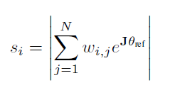
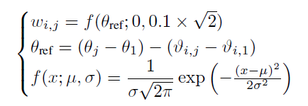
Fusion Algorithm
Matching score
$$θ∼𝒩(μ,σ)$$
Varying with $d$
$$σ=0.1$$
Matching score
Calculated using CV output
Probability of tag $∈B_{i}$
Notes:
Another factor is environmental noise. We know that tag’s phase measurements contain random errors, following a typical Gaussian distribution with a standard deviation of 0.1 radians. So we should regard the phase as a random variable instead of a constant.
Considering all this, we define the matching score of the ith motion blob as below. Specifically, we assume the tag is on the ith object, then at an arbitrary time t, we can get the object’s location P through the CV subsystem, and calculate the theoretical phase utilizing this location information. Then we compare the calculated phase with the measurement reported by the RFID reader in the meantime, to get the probability that the tag is carried by the ith object. Finally, we sum up all observations to get the matching score.

Slide 20
Fusion Algorithm
Blob matching
Matching score
Match the tag to the motion blob with the highest matching score
Notes:
For every motion blob, a corresponding matching score can be assigned. Then, the tag will be matched to the specific motion blob with the highest matching score. In the meantime, the trajectory of the tag is also obtained from the tracking results of the CV subsystem.
That’s the whole workflow of our method. Interested readers can refer to our paper for more details.

Slide 21
Implementation
& Evaluation
Notes:
We implement our system and evaluate its performance.

Slide 22
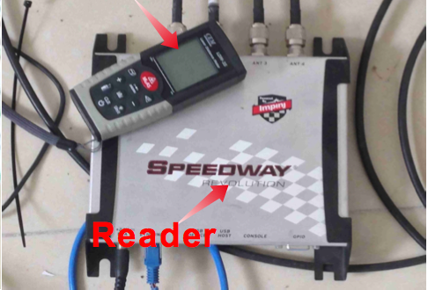
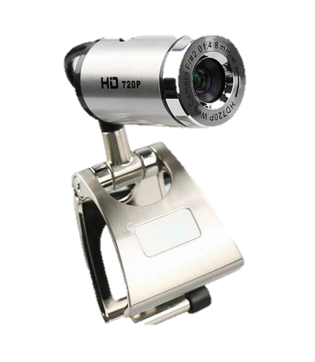
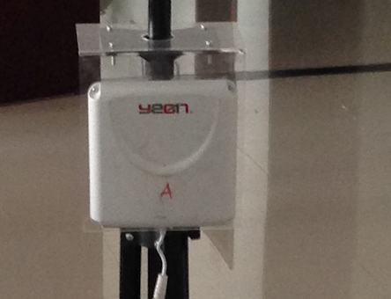
Prototype
Hardware
Software
ImpinJ R420 reader
AONI D881 HD720P camera
EPCglobal LLRP
Directional antenna
Alien tag
OpenCV
Notes:
Here are the specifications of hardware and software.
For the RFID subsystem, we adopt an ImpinJ Speedway modeled R420 reader without any hardware or firmware modification. We only employ one directional antenna with circular polarization. Two types of tags from Alien Corporation are employed.
For the CV subsystem, we use an AONI camera which is cheap and can support up to 60fps frame rate.
Software:
We adopt LLRP protocol to communicate with the reader and for object tracking, we use the OpenCV library to implement.

Slide 23
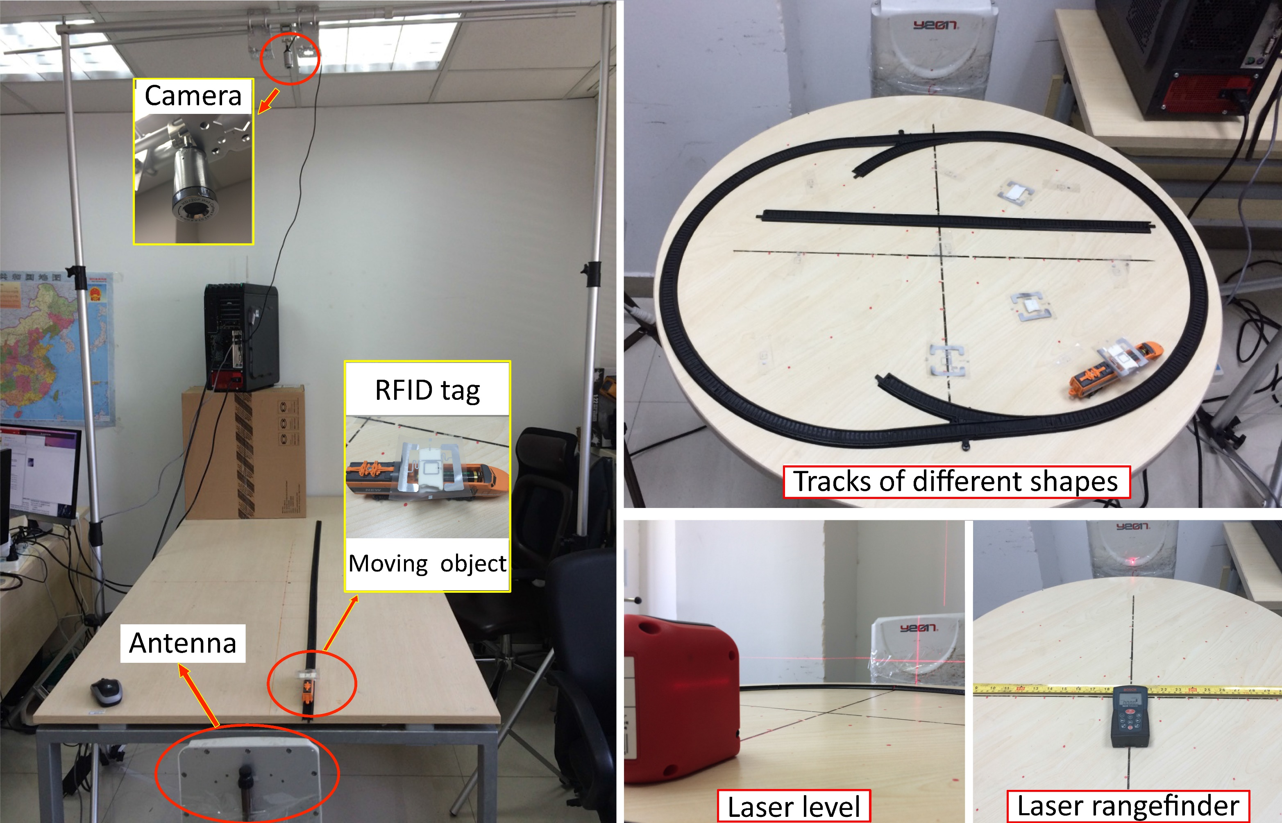
Evaluation
Experimental setup
Notes:
Here shows the experimental setup.
A mobile object is emulated via a toy train, moving on tracks of different shapes (linear or arc-shaped).
A camera is mounted on the ceiling to provide a bird’s-eye view of the surveillance region.
One reader antenna is deployed to collect the phase information of the tag.

Slide 24
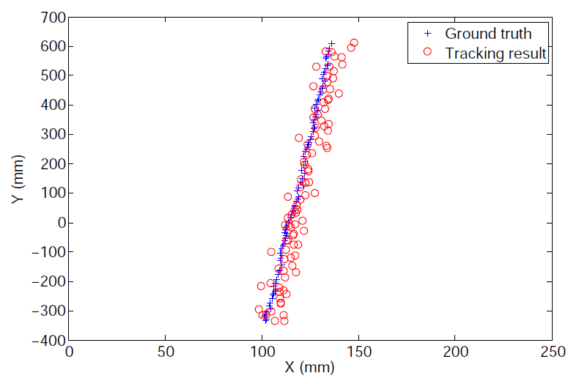
Evaluation
Tracking accuracy of CV
Mean error 5.68mm with standard deviation 4.79mm
Notes:
Here are the evaluation results. For the CV subsystem, the mean error distance is 5.68m with standard deviation of 4. 79mm. And the error mainly results from the coordinates transformation procedure.

Slide 25
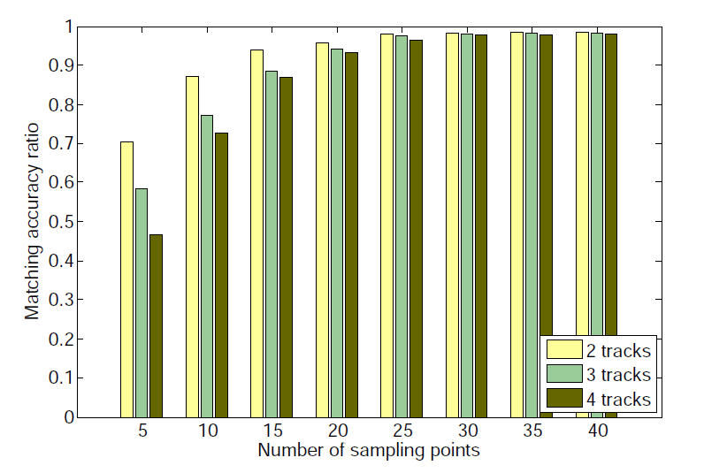
Evaluation
Blob matching accuracy
High accuracy ratio: 98% on average
Notes:
We know the blob matching module is key to the combination of the CV and RFID subsystems. Overall, the blob matching accuracy is very high, about 98% on average.

Slide 26
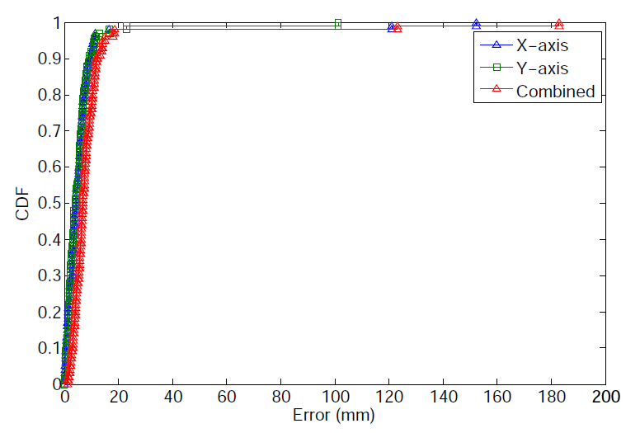
Evaluation
Overall tracking accuracy
Mean error 10.33mm with standard deviation 21.23mm
Notes:
Here is the final tracking accuracy of the RFID tag. TagVision achieves a mean error distance of 10.33mm in combined dimension with standard deviation of 21.33mm. And it’s the good performance of fusion algorithm that guarantees the final tracking accuracy of tagged object.

Slide 27
Conclusion
Our Contributions
We present a tagged object identifying and tracking system based on the fusion of RFID’s identifying strength and CV’s localization capability.
1
2
Design of the fusion algorithm.
TagVision can achieve fairly good accuracy.
3
Notes:
In summary, we present a tagged object identifying and tracking system, which complement RFID with CV’s localization capability.
Our key innovation lies in the design of the fusion algorithm.
And experimental results show that our system can achieve fairly good accuracy.

Slide 28
Thank You!
Notes:
That’s all of my talk today. Welcome for questions. Thank you!

Slide 30
RFID Subsystem
Preprocessing
Inconsistency of the two clocks
Sampling frequency
CV: 16fps, RFID: 60Hz
Clock synchronization
Timestamp warping
Connect to the same NTP server
Refer CV subsystem as benchmark
Notes:
Careful reader may remark the inconsistency of the time clocks of the two subsystems.

